Slide 1
Advanced JQuery
By Manoj Mohan

Slide 2
Agenda
Grails JQuery plugin
Callback functions
Intro to JSON
Intro to AJAX
jQuery.ajax
jQuery plugins
jQuery UI Framework

Slide 3
Grails Jquery plugin
http://www.grails.org/plugin/jquery
    It is pre installed in the grails app that you create
Put this in layout
    <g:javascript library="jquery" />
Ajax via jQuery in Partial GSP
    <g:setProvider library="jquery"/>
This will affect the tags
    <g:formRemote> , <g:remoteLink>, <g:remoteField> etc. related to ajax
<jq:jquery> grails tag
    Automatically puts the javascript statements in document ready callback

Slide 4
CallBack
A callback is a piece of executable code that is passed as an argument to other code, which is expected to call back (execute) the argument at some convenient time.

Slide 5
Callback functions
var myFunction=function(key, value){
}
function sampleFunction(x, y){
}
jQuery.each(array, myFunction)
jQuery.each(array, sampleFunction)
jQuery.each(array, function(key, value){
//Anonymous function
})

Slide 6
Know JSON
JSON (JavaScript Object Notation) is a lightweight data-interchange format.
JSON object
  an unordered set of name/value pairs
  {'key1' : value1, 'key2' : value2}
JSON Array
  an ordered collection of values
  {value1, value2, value3}
http://json.org/

Slide 7
Know JSON continued...
A value can be a string in double quotes, or a number, or true or false or null, or an object or an array.
e.g.
  "Hello String" , 123, true, false, null,
  {'name':'manoj', 'points': 10, 'male':true},
  ['cricket', 'football', 'tennis']
  {'name':'Intelligrape', 'rooms':['Matrix', 'Beach House']}

Slide 8
Traverse JSON
jQuery.each( jsonObjectOrArray, function( keyOrIndex, value ) {
console.debug( keyOrIndex )
console.debug( keyOrIndex.name )
console.debug( keyOrIndex[“name”] )
console.debug( value )
})
for( item in jsonObjectOrArray){
console.debug( item )
console.debug( jsonObjectOrArray[item] )
}

Slide 9
Intro to AJAX
AJAX = Asynchronous JavaScript and XML.
AJAX is the art of exchanging data with a server, and update parts of a web page - without reloading the whole page.
Classic web pages, (which do not use AJAX) must reload the entire page if the content should change.
With Ajax, web applications can send data to, and retrieve data from, a server asynchronously (in the background) without interfering with the display and behavior of the existing page.

Slide 10
Intro to AJAX
Examples of applications using AJAX: Google Maps, Gmail, Youtube, and Facebook tabs
Data is retrieved using the XMLHttpRequest object.

Slide 11
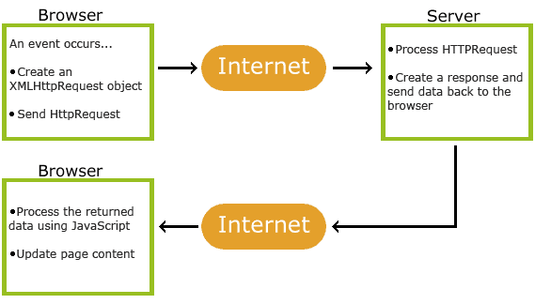
How AJAX Works

Slide 12
jQuery.ajax
The jQuery library has a full suite of AJAX capabilities. The functions and methods therein allow us to load data from the server without a browser page refresh.
jQuery.ajax({
url : "${createLink(controller:'sample', action:'handleAjax', id:100)}",
success : function(data) {
jQuery('.result').html(data);
alert('Load was performed.');
}
});

Slide 13
Shorthand methods for Ajax
get
post
getJSON
getScript
load
http://api.jquery.com/category/ajax/shorthand-methods/

Slide 14
Shorthand methods cont...
jQuery.get('ajax/test.html', function(data) {
jQuery('.result').html(data);
alert('Load was performed.');
});
jQuery.post('ajax/test.html', function(responseGot) {
jQuery('.result').html(data);
});
jQuery.post('ajax/test.html',
{'name':'manoj', 'points':10},
function(data) {
jQuery('.result').html(data);
});

Slide 15
Ajax Helper functions
useful when passing params to ajax call
  param
  serialize
http://api.jquery.com/category/ajax/helper-functions/

Slide 16
Using jQuery plugins
Jquery Validator plugin demo
  http://docs.jquery.com/Plugins/Validation
Other popular plugin groups
  Table
  Media
  Animation and Effects
http://plugins.jquery.com/projects/plugins

Slide 17
Jquery UI framework
jQuery UI provides a comprehensive set of core interaction plugins, UI widgets and visual effects that use jQuery.
  Accordian
  AutoComplete
  Datepicker
  Dialog
  Progressbar
  Slider
  Tabs
http://jqueryui.com/demos/

Slide 18
Useful Links
http://json.org/
http://api.jquery.com/jQuery.parseJSON/
http://www.grails.org/plugin/jquery
http://api.jquery.com/jQuery.ajax/
http://api.jquery.com/category/ajax/shorthand-methods/
http://api.jquery.com/category/ajax/helper-functions/
http://docs.jquery.com/Plugins/Validation
http://www.tvidesign.co.uk/blog/improve-your-jquery-25-excellent-tips.aspx
http://jqueryui.com/demos/

Slide 19
Questions?

